Slide 1

Stock Market
iOS App
INFO6350 - Final Project Presentation
Presented by:
Shardul Surve (002791555)
Shubham Bagal (002708621)

Slide 2
Key Features
01
Real-Time Market Data
03
Portfolio Management
05
Mobile Accessibility
02
User-Friendly Interface
04
Stock Research and Analysis
06
Security and Privacy

Slide 3
Tech Stack
Softwares, Tools, APIs that we used to build the App
01
03
SwiftUI
Xcode IDE
02
04
Finhub.io API (For Real-Time data)
Firebase (Database)

Slide 4
Core Functionalities:
01
Search stocks (Real -Time data
03
Buy/Sell Stocks
02
04
Bookmark/Wishlist
Statistics

Slide 5
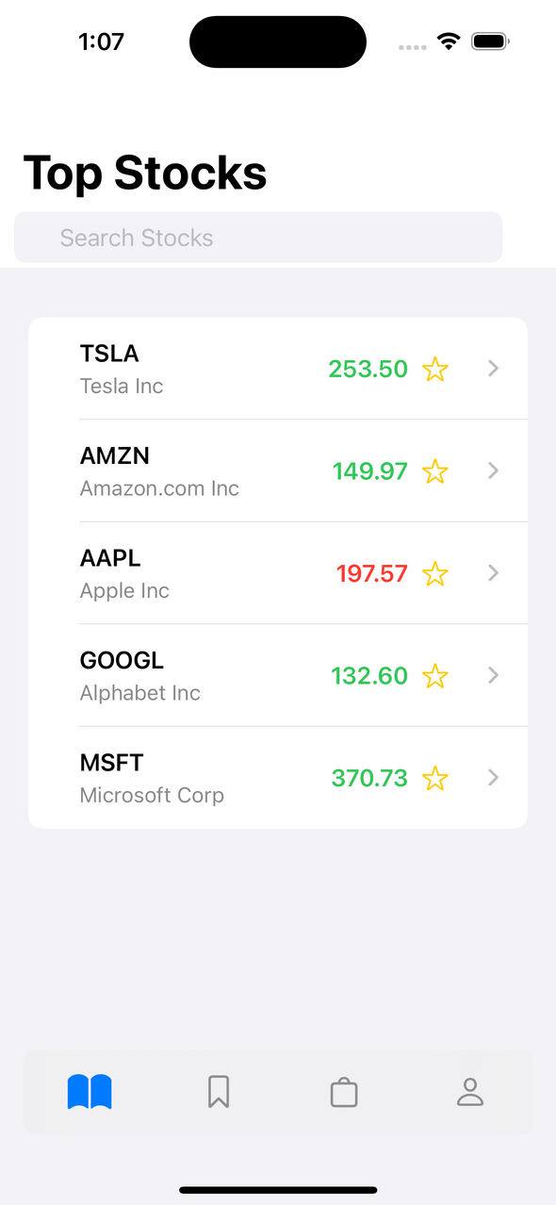
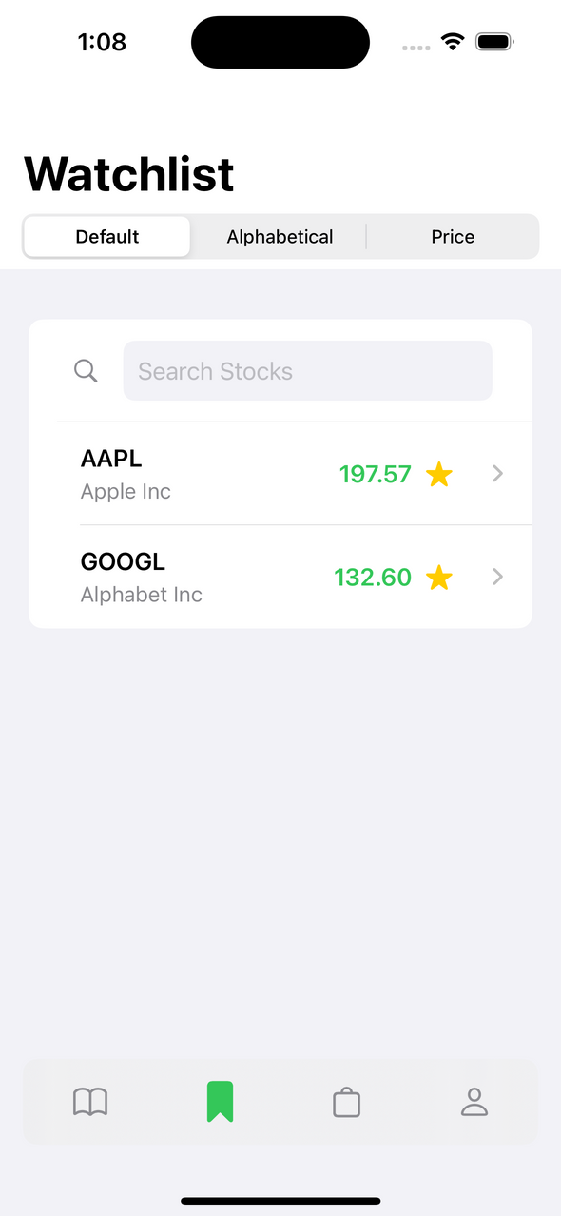
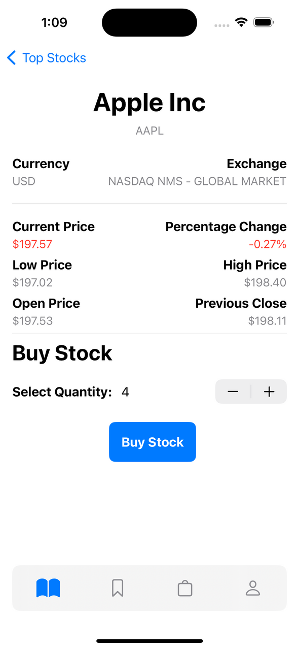
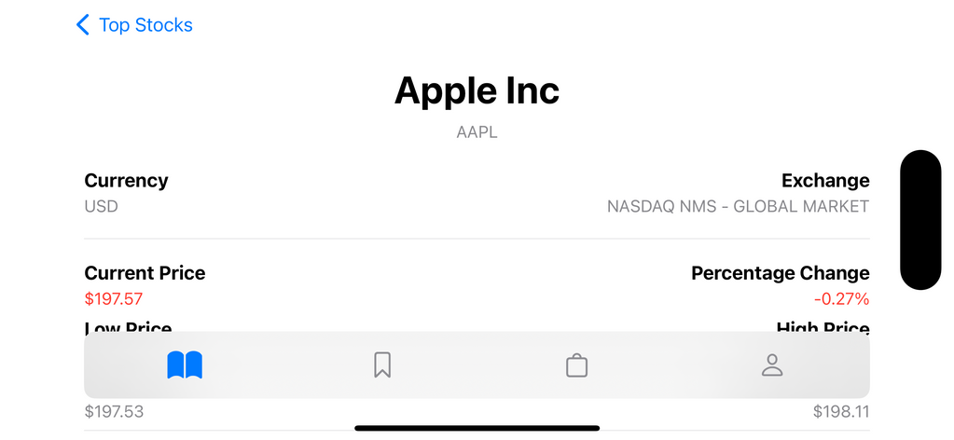
User Interfaces

Slide 6

Future Scope
High availability API integration
Advanced Statistical Analysis
Improving Security and consistency
Stock Recommendation using Risk Analysis

Slide 7

The
Conclusion
Acquire skills in designing an aesthetically pleasing and user-friendly interface
Enhance proficiency in using the SwiftUI framework for iOS app development
Integrate external APIs into Application for Real-Time data processing
Ability to understand user requirements, and design application based on modularity

Slide 8

Thank You

